Slide 1
ECEE AMP Options
Formerly called 4+1

Slide 2
What is AMP?
AMP stands for Accelerated Master's Program.
It was formerly called 4+1 program, so you might hear that term as well.
You share/reserve classes between your bachelor's and master's degrees to reduce your total time to degree and cost.

Slide 3
What programs are available to you?
All of our graduate programs are available.
Note that the EE MSE program is offered both online and at Tempe. This is the only online program.
Refer to the AMP website for the links to the graduate programs and their degree requirements.

Slide 4
Definitions- Shared vs Reserved
Shared
Shared means that these classes will be shared between the your BSE and MSE/MS.
Reserved
Reserved means that the course(s) will be taken while you are a BSE student, but will not count towards your BSE. They will be reserved for future use in the MSE/MS program.

Slide 5
Important information
No more than 3 classes can be shared between the BSE and MSE/MS.
You cannot exceed more than 12 credits total of shared and reserved credits.

Slide 6
When should you apply?
Generally, before you start Senior Design.
You need to have completed at least 90 credit hours.
You should apply before you start taking (or finish taking) your 400 level classes.
Your 400 level classes would be the shared/reserved classes.
You need to meet the strict GPA requirement.

Slide 7
GPA Requirements
3.0 cumulative or major GPA.
Find your major GPA in your DARS (you will need to know it for the application).

Slide 8
How to apply
Start filling out the application that is on the website.
Send your started/completed application to the 4+1 coordinator to review to provide feedback on or approve.
Meet with the 4+1 coordinator if needed or if you have specific questions.
Follow any additional instructions the 4+1 coordinator gives you.

Slide 9
Resources to use when applying
Graduate program handbooks to see what the degree requirements are.
Recommended prerequisites to see how you should prepare for the graduate classes.
Tentative three year plan so you can plan out your future classes.
All of these resources are found on the AMP website.

Slide 10
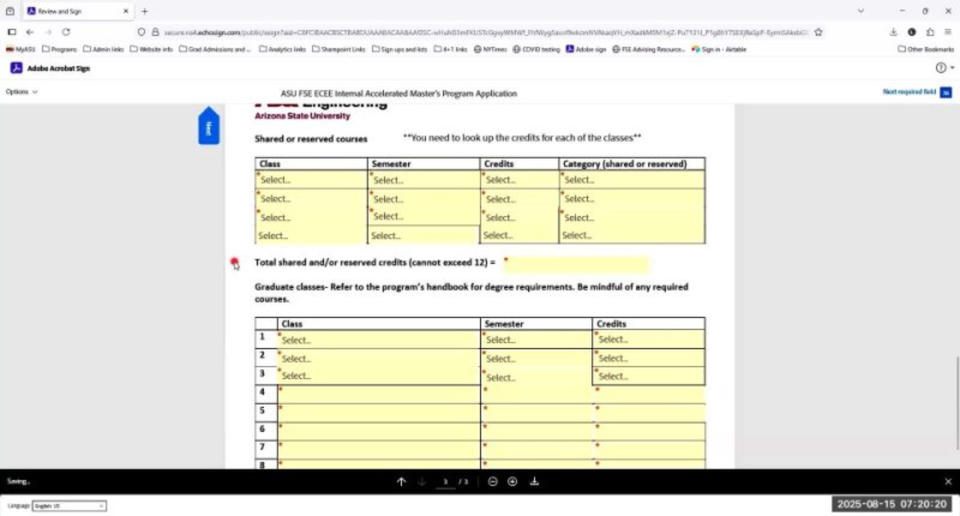
Sample application walk through

Slide 11
Frequently asked questions
What if my plans change and I want to withdraw?
No worries! We are here to help you no matter what. There is no penalty for withdrawing from this program.
I need to list 10 classes for my MSE/MS program, but I don’t know what I will take or what will be offered.
That happens all the time. Just list classes that meet the degree requirements.
What if I want to change my area of specialization or classes?
You can do that! Just let the AMP coordinator know.

Slide 12
Important resources
Websites
EEE Recommended prerequisites
ECEE Tentative 3 year plan
AMP Website with links to the graduate handbooks
AMP coordinator
James VanderPloeg
Academic Success Coordinator
ECEEGrad@asu.edu
480-965-3424, call to schedule an appointment

